Slide 1



Water Quality Prediction
Name: Angothu Adhisheshu
AICTE Internship Student Registration ID : STU679b74f8cf4971738241272

Slide 2

Learning Objectives
Water Pollutant Prediction :
Understand the process of deploying a machine learning model using Streamlit for real-time predictions.
Learn how to load and use pre-trained models (.pkl) for making predictions on new input data.
Gain experience in data preprocessing, including one-hot encoding and aligning features with the model's input structure.
Develop skills in building a user-friendly interface to collect inputs and display prediction results.
Apply knowledge of Python libraries such as pandas, joblib, and Streamlit in a practical project.
Understand the environmental application of AI by predicting key water pollutant levels based on temporal and location-based inputs.
GOAL
Source :
www.freepik.com/

Slide 3
Tools and Technology used
Python: Primary language for data processing, modeling, and application development.
Jupyter Notebook (.ipynb): Used for exploratory data analysis, model training, testing, and debugging.
Pandas & NumPy: For handling tabular data and performing numerical computations.
Joblib & Pickle: To save and load machine learning models and associated metadata efficiently.
Scikit-learn (implied in the model): Likely used for building and training regression models.
Streamlit: Lightweight web framework to deploy the ML model as an interactive application.
Machine Learning Model: Used for multi-output regression to predict pollutant levels.
One-Hot Encoding (via get_dummies): To preprocess categorical variables like Station ID.
Version Control (GitHub) (if applicable): For managing code versions and collaborative development.
UI Elements (Streamlit Widgets): Number input, text input, button, and formatted output for end-user interaction.

Slide 4
Methodology
Model Development & Preparation:
Data Collection: Collected historical water quality data including pollutants, year, and station ID.
Data Preprocessing:
Cleaned and structured the dataset using pandas.
Applied encoding techniques (e.g., one-hot encoding for Station ID).
Prepared feature columns for consistent model input.
Model Training (done in .ipynb):
Trained a regression or multi-output regression model to predict pollutant levels.
Evaluated performance using appropriate metrics (e.g., MAE, RMSE).
Saved the model and column metadata using joblib for deployment.

Slide 5
Deployment with Streamlit:
Model Loading:
Loaded the trained model and required column structure using joblib in Streamlit.
User Interface Development:
Created a web interface using streamlit with input fields for Year and Station ID.
Used Streamlit widgets like number_input, text_input, and button.
Prediction Workflow:
Encoded user inputs to match the trained model’s format.
Aligned input columns with model_columns.pkl.
Used the model to predict pollutant levels and displayed results with formatted output.
Output:
Predicted levels of pollutants such as O₂, NO₃, NO₂, SO₄, PO₄, and Cl.
Provided a user-friendly way to assess water quality by year and station.

Slide 6
Problem Statement:
Context & Challenges:
Context
Water pollution poses a serious threat to ecosystems, public health, and water security. Regular monitoring and prediction of pollutant levels is essential for effective environmental management.
Key Challenges
Manual water quality testing is time-consuming and resource-intensive.
Inconsistent or missing data from different monitoring stations.
Lack of predictive tools to estimate pollutant levels in advance.
Difficulty in real-time decision-making for environmental agencies.
Need for a user-friendly system that provides pollutant insights quickly.

Slide 7
Objectives & Need for Solution:
Project Objective
To build a machine learning-powered application that can predict key water pollutant levels based on inputs like Year and Station ID, helping agencies take preemptive actions.
Why This Solution Matters
Automates the prediction of multiple pollutant levels (O₂, NO₃, NO₂, SO₄, PO₄, Cl).
Provides faster and more scalable water quality assessments.
Supports data-driven decisions for pollution control and environmental planning.
Enables easy deployment and use through a Streamlit web app.
Bridges the gap between raw data and actionable insight.

Slide 8
Solution:
Technical Approach:
Machine Learning-Based Prediction System
Developed a predictive model using historical water quality data.
Used multi-output regression to estimate levels of multiple pollutants (O₂, NO₃, NO₂, SO₄, PO₄, Cl).
Encoded categorical features (e.g., Station ID) using one-hot encoding.
Saved the trained model and feature structure using joblib for reuse.
Streamlit Deployment
Built a web-based app using Streamlit for user-friendly input and output.
Enabled real-time predictions based on user-provided Year and Station ID.
Designed a simple and accessible interface with clear pollutant outputs.

Slide 9
Benefits & Impact:
System Benefits
Automation: Eliminates manual prediction and analysis processes.
Scalability: Predicts pollutant levels for any year and station using minimal input.
Speed: Instant results improve responsiveness in environmental monitoring.
Simplicity: User-friendly interface allows even non-technical users to interact easily.
Environmental Impact
Supports proactive pollution control by forecasting harmful levels in advance.
Enhances data-driven environmental decision-making for government and agencies.
Helps in monitoring compliance with water quality standards and reducing ecological risk.

Slide 10
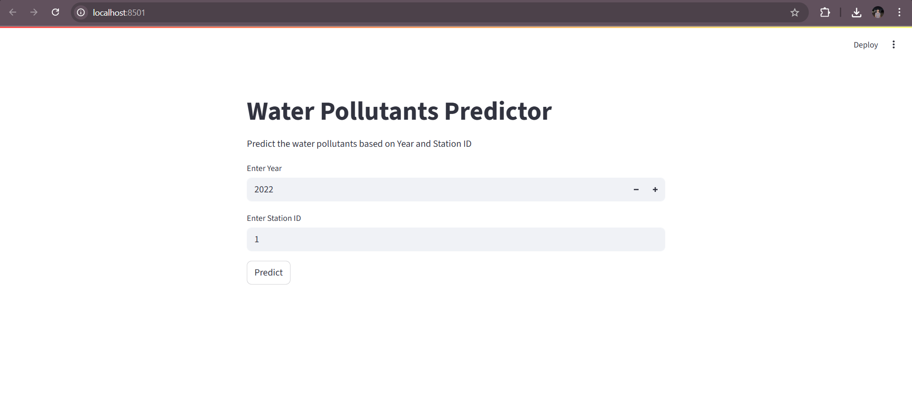
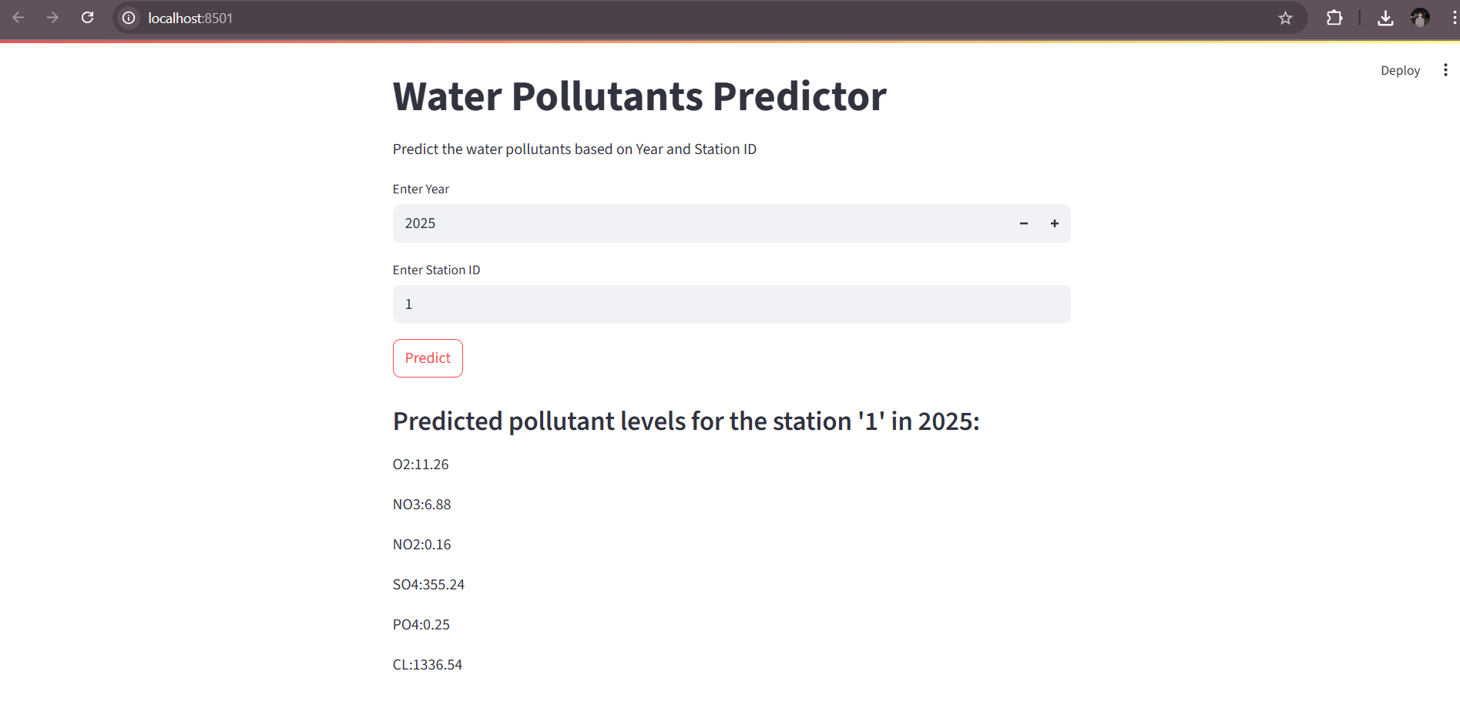
Screenshot of Output:

Slide 11
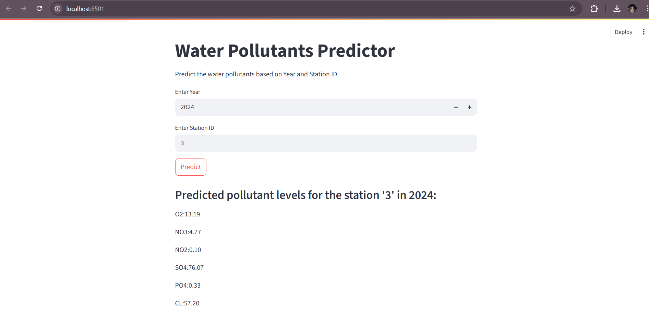

Slide 12
Conclusion:
This project successfully integrates machine learning and interactive web development to create a practical solution for predicting water pollutant levels. By training a multi-output regression model using historical water quality data and deploying it through a Streamlit app, users can quickly estimate concentrations of key pollutants like O₂, NO₃, NO₂, SO₄, PO₄, and Cl. This enables timely water quality assessments with minimal input requirements.
The application is intuitive and accessible, allowing users to make real-time predictions using just the year and station ID. It enhances environmental monitoring efforts, supports regulatory compliance, and helps stakeholders make informed decisions to protect water resources. The tool effectively bridges the gap between raw data and actionable environmental insights.

Slide 13
Key Takeaways
✅ Automates prediction of multiple water pollutants in real time.
✅ Makes environmental monitoring faster, easier, and more scalable.
✅ Provides a simple, interactive interface for users via Streamlit.
✅ Supports proactive decision-making for pollution control.
✅ Demonstrates the real-world application of machine learning in sustainability.

